Slide 1
Social Emotional Learning Institute
Session 3
Friday, April 11
Notes:
Katie

Slide 2
Welcome!
Introductions
In the chat, please provide an example of how you’ve included/embedded SEL within a lesson. If you haven’t yet, consider how you might use one of the 3 signature practices: inclusive welcome, engaging strategy, or intentional close.
Notes:
Katie

Slide 3
Session Pre-reading
Aligning SEL and Academic Objectives https://schoolguide.casel.org/focus-area-3/classroom/integration-of-sel-and-instruction/aligning-sel-and-academic-objectives/
Transforming Education's SEL Integration Approach for Classroom Educators https://files.cdn.thinkific.com/file_uploads/276216/attachments/6f8/5c2/b76/SEL-Integration-Approach-Quick-Reference-Guide.pdf
Notes:
Katie

Slide 4
Session Pre-reading
Participants choose 2-3 additional resources to read/explore by topic area:
General Strategies for Integrating SEL
SEL for English Learners
SEL in Music
SEL in Early Childhood/Early Elementary
SEL in Elementary Literacy
SEL in HS – Language Arts/Literacy
SEL in Math
SEL in Science
Notes:
Katie

Slide 5
Purpose of COE Learning Institutes
The College of Education, in partnership with Oregon's Higher Education Coordination Commission (HECC), is committed to supporting statewide efforts to enhance opportunities for preservice teachers and faculty to engage in state and district curriculum and instruction initiatives.
Within this partnership there is an emphasis on supporting the ODE equity and inclusion framework when implementing new state standards. ODE's newly adopted SEL standards are the focus of the COE Learning Institutes for this year.
Notes:
Katie

Slide 6
Social and Emotional Learning Institutes
Session #1 – Transformative Social Emotional Learning – January 10
Session #2 – Supportive Classroom Environment – February 28
Session #3 – Integrating Social Emotional Learning and Instruction – April 11
“When integrated with academics, SEL can help to transform students’ experiences of the classroom by putting them in the driver’s seat as they grapple with content, collaborate with peers, set meaningful goals, and communicate effectively, all within a supportive and challenging classroom environment. These experiences are part of a high-quality and equitable education, and there is promise that they will lead to improved academic and social-emotional outcomes for students” (https://schoolguide.casel.org/focus-area-3/classroom/integration-of-sel-and-instruction/)
Notes:
Katie

Slide 7
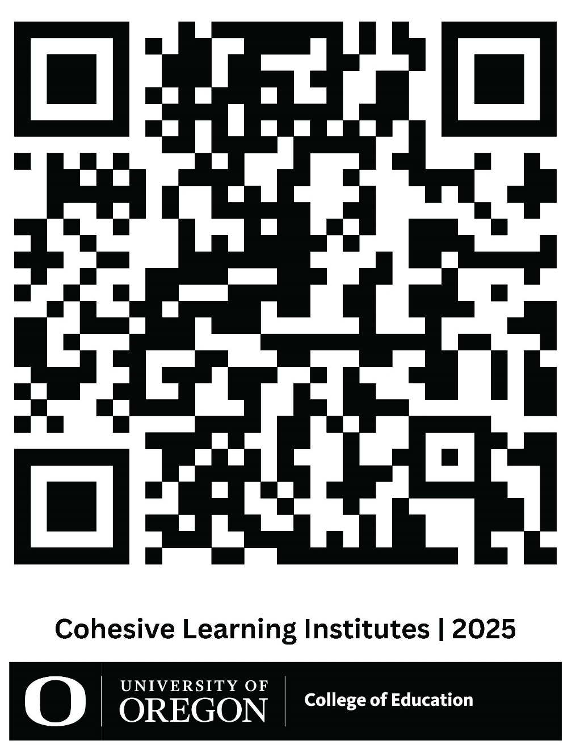
Cohesive Learning Institutes
Session 3 - Online Materials
You can use the web link below or scan the QR code if you would like to go to the website containing today’s participant slides, participant handout, and online materials.
Cohesive Learning Institutes | College of Education
Notes:
Katie

Slide 8
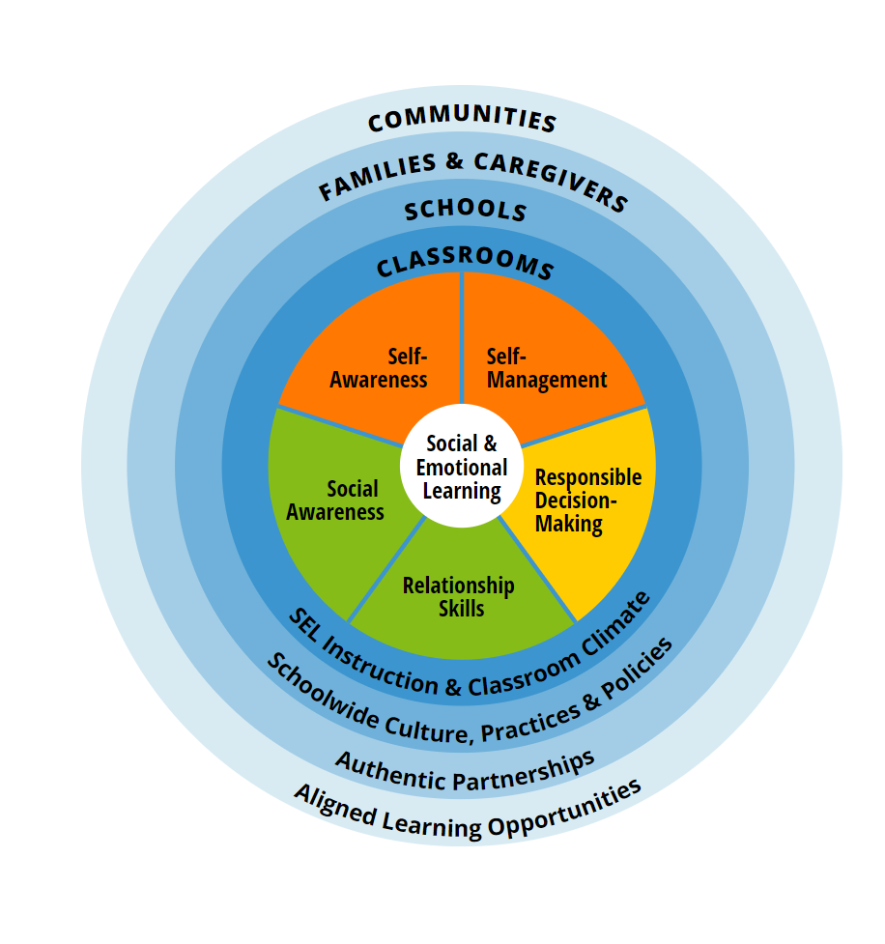
Oregon Department of Education Transformative SEL Framework
Collaborative for Academic, Social, and Emotional Learning (CASEL)
Notes:
Gounah

Slide 9
WELCOMING ACTIVITIES
ENGAGING PRACTICES
OPTIMISTIC CLOSURES
Notes:
Gounah

Slide 10
Classroom
Foster supportive classroom environments where students engage in explicit social and emotional learning and teachers integrate SEL throughout their teaching
Supportive Environment
Community Building
Belonging and Emotional Safety
Student-centered discipline
Explicit Instruction
Sequenced activities
Active learning
Focused on SEL skills
Explicit SEL objectives
Integration of SEL in Instruction
Fostering an academic mindset
Aligning SEL and academic objectives
Notes:
Elisa

Slide 11
Classroom
Integration of social emotional learning into academics that weaves deep academic learning with opportunities for students to understand their own emotions, understand diverse perspectives, show empathy, cultivate trusting relationships, solve problems collaboratively, and make decisions while considering the needs of others.
Integration of SEL into academics
Taking a student-centered approach in planning learning experiences
Aligning SEL and academic objectives so SEL can be embed in the context of lessons
Using interactive pedagogy to foster collaboration and personal reflection
Notes:
Elisa

Slide 12
Integrating SEL in Instruction
Social Emotional Learning
Universal Design for Learning
Culturally Responsive/Sustaining Practices
Trauma Informed Practices
Notes:
Elisa
Image: https://www.freepik.com/premium-vector/girl-flat-multitasking-time-management_89878901.htm#fromView=keyword&page=1&position=7&uuid=6247d597-79fe-4897-8861-53f082f6345d&query=Multitasking+Woman
Highlight existing practices that support SEL (e.g., building relationships, improving access through UDL/engagement/choice).

Slide 13
Integrating SEL in Instruction
Lesson Planning
https://schoolguide.casel.org/uploads/sites/2/2018/12/SEL-Integrated-Lesson-Planning-Checklist-10.07.24.pdf
Connect Academic and SEL learning objectives
Ask Open-Ended Questions
Build in Opportunities for Choice
Include more partner discussions
Structure tasks to require collaboration
Anticipate differences
Save time for a closing reflection
SEL Signature practices
Welcoming Activities
Engaging Practices
Optimistic Closures
UDL – Multiple means of…
Engagement
Representation
Action & Expression
Notes:
Elisa
https://schoolguide.casel.org/uploads/sites/2/2018/12/SEL-Integrated-Lesson-Planning-Checklist-10.07.24.pdf

Slide 14
Including Explicit SEL Instruction in a Content Area Classes
Sequenced | Active | Focused | Explicit
Instruction is planned in a series of connected and coordinated steps so that social and emotional skills build upon each other and are strengthened over time For example, we may need practice recognizing and managing emotions before we are ready to attempt conflict resolution. | Instruction uses active forms of learning to help students master new skills For example, experiential or project-based learning, real-life application, discussion, or problem-solving scenarios. | Time and attention is devoted to developing personal or social skills. It is intentional rather than incidental. | Instruction targets a specific social and emotional skill or goal; students are made aware of what they are learning and practicing.
Notes:
Katie
Consider including Explicit SEL Instruction (if time; otherwise, provide as resource; https://schoolguide.casel.org/focus-area-3/classroom/explicit-sel-instruction/)

Slide 15
SEL & Group Lab Roles in a Science Classroom
Oregon SEL Standard 4: Establish and maintain healthy, supportive relationships and effectively navigate diverse settings in order to collaboratively solve problems.
Sequenced
Beginning of the Year | Middle of the Year | End of the Year
Explicitly teach the lab roles; model what each lab role looks like; have cards at each lab table that remind them of their roles; have students practice the lab role in a lab that is less technical or content heavy; keep track of which lab roles students have practiced; rotate students through the lab roles; | Review lab roles and re-teach what the roles look like; add an additional role if appropriate; keep using the same roles over and over so students become proficient in all roles | Reflect on how students improved in their use of the roles throughout the year; Connect to SEL Standard 4
Notes:
Katie

Slide 16
SEL & Group Lab Roles in a Science Classroom
Oregon SEL Standard 4: Establish and maintain healthy, supportive relationships and effectively navigate diverse settings in order to collaboratively solve problems.
Active | Focused | Explicit
Engaging in inquiry based labs in a science classroom | Explicitly teaching the lab roles Reflect on how the lab roles when in class that day Have student self-assess how they did in their role Note areas of strength for the class and where they can improve | Oregon SEL Standard 4 Explicitly tell students that these roles help them to maintain supportive relationships and improve their collaborative problem solving skills
Notes:
Katie

Slide 21
Engaging Practices: Breakout rooms
Breakout room discussion guide
(Available online)
Current practices that support students' SEL
SEL-Integrated lessons
Practices for integrating SEL
School-wide SEL efforts
Notes:
Julie – update
Katie - transition

Slide 22
Breakout rooms
UOTeach | Choose the breakout room with your university supervisor
School district educators | Choose the breakout room with your teacher candidate and university supervisor
Music Education | Choose the breakout room with Facilitator: Becky Casado & Zehra Greenleaf
Special Education (K-12) | Choose the breakout room with Facilitator: Elisa Jamgochian & Kyle Reardon
Early Intervention | Choose the breakout room with Facilitator: Tina Gutierez Schmich & Gounah Choi
School Psychology | Choose the breakout room with Facilitator: Erika Case & Maureen Spence
Notes:
Julie - update

Slide 23
Breakout room discussions
What were some ideas, strategies, successes, or wonderings from your discussions?
Notes:
Gounah

Slide 24
Optimistic Closure
Consider one of the following… Share out.
What have you learned in these sessions that you plan to apply in the year ahead? (Or to your practice?)
What message of encouragement do you want to send yourself related to SEL implementation?
What reminder(s) do you want to capture in writing and send to your future self?
Notes:
Gounah

Slide 25
End-of-Institute Survey
Please take 2-3 minutes to complete this post-assessment:
https://docs.google.com/forms/d/e/1FAIpQLScpvR_iRYeJKuQF6LD2ScX2ltiHwHIQm7xHf4LICTt2w2pHXg/viewform?usp=dialog
Notes:
Gounah

Slide 26
Take away
Link to SEL Reflection Prompts (about 1/3 down page) https://schoolguide.casel.org/focus-area-3/classroom/explicit-sel-instruction/
SEL-Integrated Sample Lesson Plans https://schoolguide.casel.org/focus-area-3/classroom/integration-of-sel-and-instruction/
SEL Integrated Lesson Planning Checklist https://schoolguide.casel.org/uploads/sites/2/2018/12/SEL-Integrated-Lesson-Planning-Checklist-10.07.24.pdf
Explicit SEL Instruction https://schoolguide.casel.org/focus-area-3/classroom/explicit-sel-instruction/
Notes:
Gounah

Slide 27
Thank You So Much
Notes:
Gounah

