Slide 1
Social Emotional Learning Institute
Session 2
Friday, February 28
Please rename yourself on zoom:
First name, last name, school district or program

Slide 2
Welcome!
Introductions
What is a favorite SEL classroom activity that you currently use in your classroom or are planning to use in your classroom?

Slide 3
Session Pre-reading
A Supportive Classroom Environment | CASEL
https://schoolguide.casel.org/focus-area-3/classroom/a-supportive-classroom-environment
How to Foster a Growth Mindset in the Classroom
https://soeonline.american.edu/blog/growth-mindset-in-the-classroom/
Fostering Academic Mindsets
https://schoolguide.casel.org/focus-area-3/classroom/integration-of-sel-and-instruction/fostering-academic-mindsets/
SEL in the Classroom Self-Assessment
https://schoolguide.casel.org/resource/sel-in-the-classroom-self-assessment/

Slide 4
Session Pre-reading
Participants choose 2-3 additional resources to read/explore:
Promoting Young Children’s Social and Emotional Health https://www.naeyc.org/resources/pubs/yc/mar2018/promoting-social-and-emotional-health
3 Ways to Integrate SEL into Classroom Practices https://www.edutopia.org/article/sel-strategies-classroom-management
Invite Students to Co-Design their learning environment https://iste.org/blog/Invite-students-to-co-design-their-learning-environment
Is Your Classroom Academically Safe? https://www.cultofpedagogy.com/academic-risk-taking/
Restorative Practices: Fostering Healthy Relationships and Promoting Positive Discipline in Schools https://files.cdn.thinkific.com/file_uploads/276216/attachments/e8c/81e/17e/restorative-practices-guide.pdf
Developing Academic Mindsets that Foster Growth, Development and Innovation https://katielmartin.com/2017/09/07/developing-academic-mindsets-that-foster-growth-development-and-innovation/
TED Talk | Rita Pierson | Every Child Needs a Champion Rita Pierson - https://www.ted.com/talks/rita_pierson_every_kid_needs_a_champion?subtitle=en
Accentuate The Positive: The transformative power of small encouragements and welcoming interactions https://www.gse.harvard.edu/ideas/usable-knowledge/16/12/accentuate-positive
Incorporating Indigenous Practices to support Social Emotional Learning
https://ospi.k12.wa.us/sites/default/files/2023-10/incorporating_indigenous_practices_508c.pdf
10. Whole Child Approach-National Indian Education Association
https://www.niea.org/whole-child-approach
11. Building a space to dream: Supporting Indigenous children's survivance through community-engaged social and emotional learning
https://srcd.onlinelibrary.wiley.com/doi/full/10.1111/cdev.13786
12. Supporting Students Who Are Often Absent
https://www.learningforjustice.org/magazine/supporting-students-who-are-often-absent
13. SEL for English Language Learners: What Educators Need to Know
https://www.colorincolorado.org/article/sel-english-language-learners-what-educators-need-know

Slide 5
Purpose of COE Learning Institutes
The College of Education, in partnership with Oregon's Higher Education Coordination Commission (HECC), is committed to supporting statewide efforts to enhance opportunities for preservice teachers and faculty to engage in state and district curriculum and instruction initiatives.
Within this partnership there is an emphasis on supporting the ODE equity and inclusion framework when implementing new state standards. ODE's newly adopted SEL standards are the focus of the COE Learning Institutes for this year.

Slide 6
Social and Emotional Learning Institutes
Session #1 – Transformative Social Emotional Learning – January 10
Session #2 – Supportive Classroom Environment – February 28
Session #3 – Integrating Social Emotional Learning and Instruction – April 11
Transformative SEL enables students and adults to be affirmed in their identities, where they can develop a sense of agency and belonging, engage in collaborative problem-solving, and deepen their curiosity about the kind of society they want to make a reality.

Slide 7
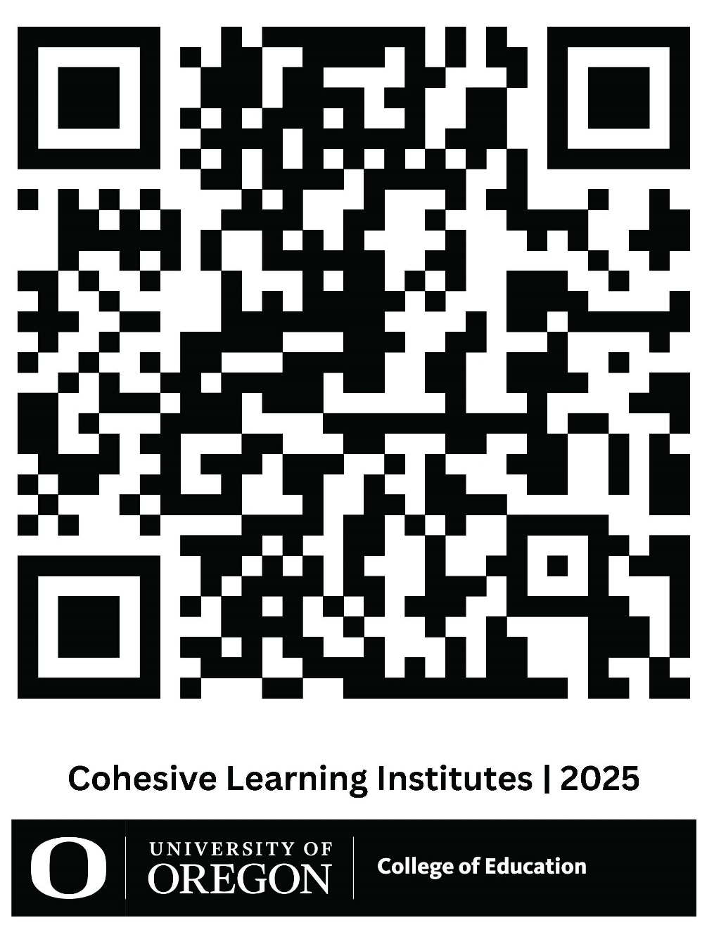
Cohesive Learning Institutes
Session 2 - Online Materials
You can use the web address below or scan the QR code if you would like to go to the website containing today’s participant slides, participant handout, and online materials.
Cohesive Learning Institutes | College of Education

Slide 8
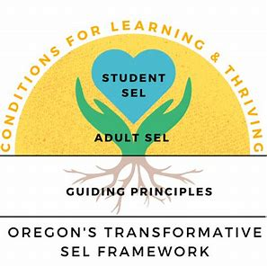
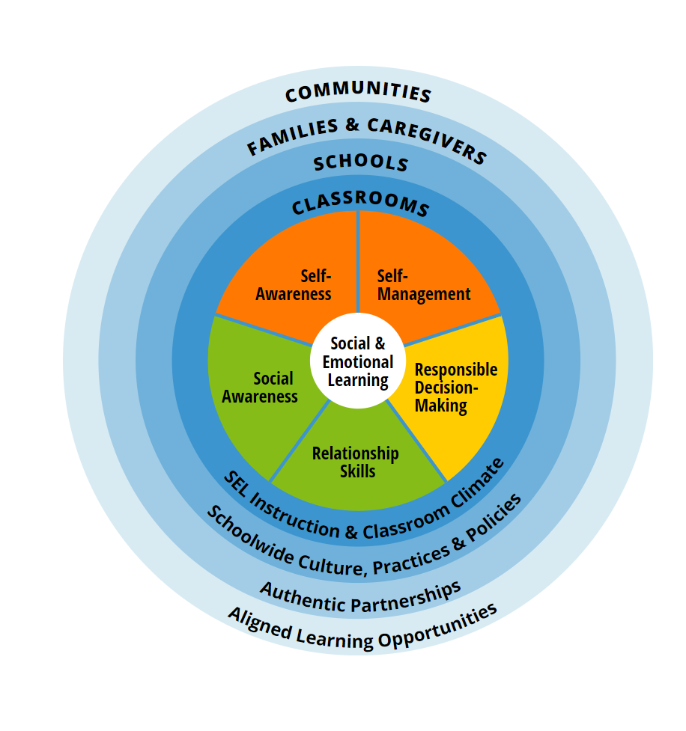
Oregon Department of Education Transformative SEL Framework
Collaborative for Academic, Social, and Emotional Learning (CASEL)

Slide 9
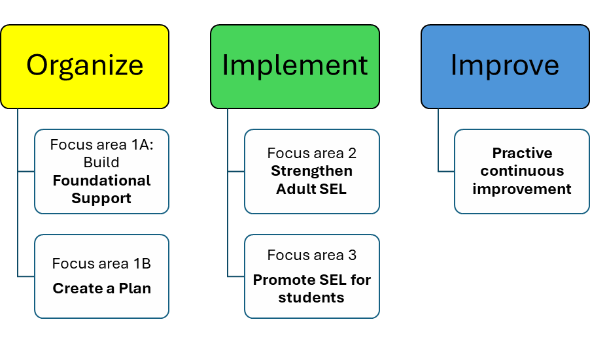
CASEL Organizational Framework

Slide 10
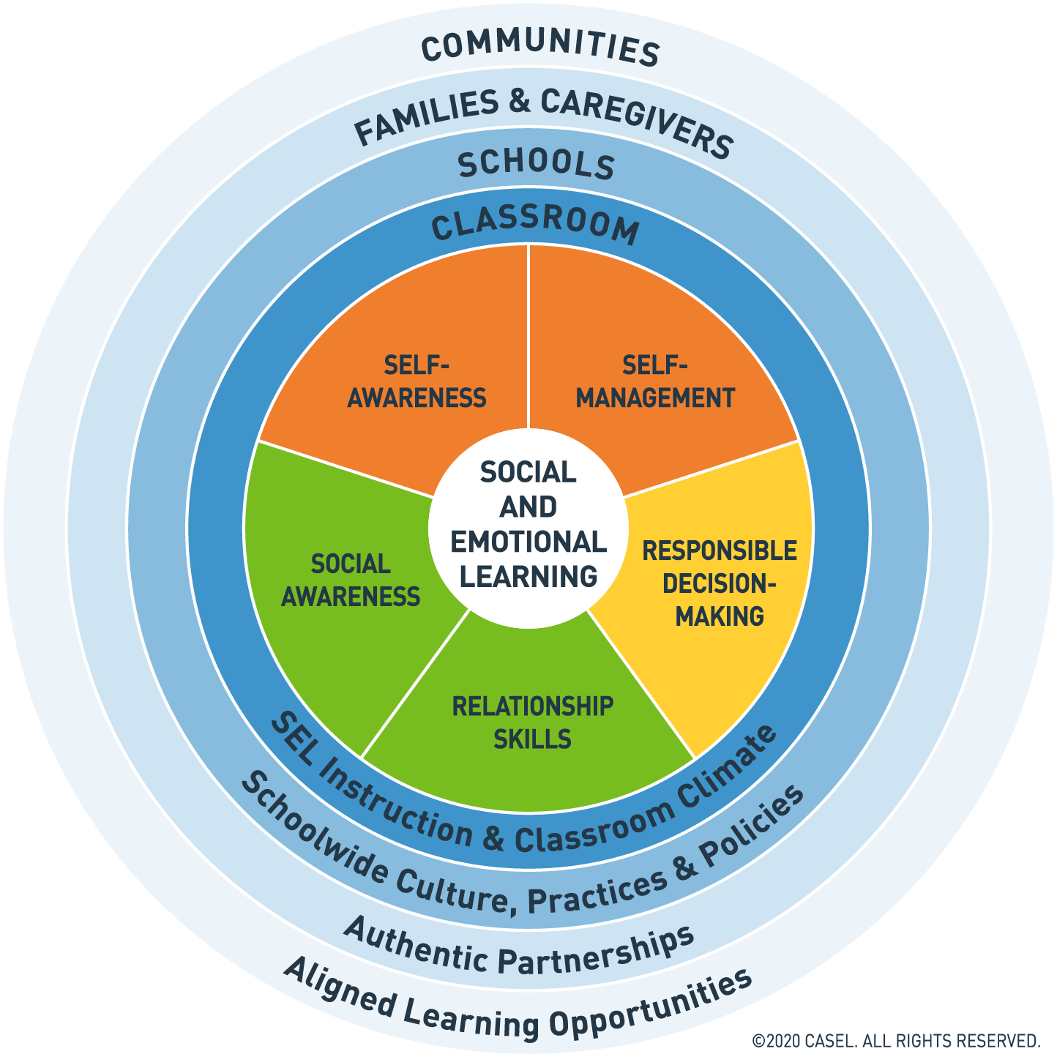
Focus 3
Develop a coordinated approach for supporting students’ social and emotional learning across the school, classrooms, homes, and communities.

Slide 11
Promoting Social Emotional Learning for Students
Develop a coordinated approach for supporting students' social and emotional learning across the school, classrooms, homes, and communities.
School
Classroom
Family Partnerships

Slide 12
SCHOOL
Align school climate, programs, and practices to promote social emotional learning for students
Do our student voice practices, student support services, discipline policies, and school climate support our school’s SEL goals?
Have we adopted an evidence-based program that is a good fit for our community?
In classrooms do we foster supportive environments, relationship building, and integrate SEL into instruction?
Are we partnering with families for SEL and modeling strong two way communication?
Have we aligned our work with community partners to support our SEL goals?

Slide 13
Schools
Promoting SEL for students requires more than SEL instruction in the classroom
SEL for students begins with fostering a warm, nurturing, and motivating school climate where every interaction with peers and adults supports students socially and emotionally.
SEL for students involves creating consistent opportunities throughout the school day to practice skills that reinforce SEL instruction and make SEL relevant to students’ daily lives.
SEL for students also means seamlessly integrating SEL into all of your schools programs and practices.

Slide 14
Schools
Creating a common language and goals between programs
PBIS/behavior supports
Restorative Practices
School safety programs
Mentoring/tutoring
Mental health supports
Student support services
Family programs

Slide 15
Promoting Social Emotional Learning for Students
Develop a coordinated approach for supporting students' social and emotional learning across the school, classrooms, homes, and communities.
School
Classroom
Family Partnerships

Slide 16
CLASSROOM
Foster supportive classroom environments where students engage in explicit social and emotional learning and teachers integrate SEL throughout their teaching
Supportive Environment
Community Building
Belonging and Emotional Safety
Student-centered discipline
Explicit Instruction
Sequenced activities
Active learning
Focused on SEL skills
Explicit SEL objectives
Integration of SEL in Instruction
Fostering an academic mindset
Aligning SEL and academic objectives

Slide 17
Classroom
Students feel emotionally safe, part of the community of leaners, motivated
and challenged.
Supportive classroom climate
Routines and structures
Shared agreements and goals
Identity-affirming practices
Systematic opportunities for youth voice
Student-centered discipline practices
Supportive classroom climate
Explicit SEL instruction
Integration of SEL into academics

Slide 18
Classroom
Explicit social and emotional learning that provides direct, consistent opportunities for students to cultivate, practice ,and reflect on social and emotional competencies that are developmentally appropriate and culturally responsive.
Explicit SEL Instruction
Dedicated time in all classrooms schedules for SEL instruction
Use of evidence-based programs or strategies and training to teach SEL effectively
Supportive classroom climate
Explicit SEL instruction
Integration of SEL into academics

Slide 19
Classroom
Integration of social emotional learning into academics that weaves deep academic learning with opportunities for students to understand their own emotions, understand diverse perspectives, show empathy, cultivate trusting relationships, solve problems collaboratively, and make decisions while considering the needs of others.
Integration of SEL into academics
Taking a student-centered approach in planning learning experiences
Aligning SEL and academic objectives so SEL can be embed in the context of lessons
Using interactive pedagogy to foster collaboration and personal reflection
Supportive classroom climate
Explicit SEL instruction
Integration of SEL into academics

Slide 20
Promoting SEL for Students
Develop a coordinated approach for supporting students' social and emotional learning across the school, classrooms, homes, and communities.
School
Classroom
Family Partnerships

Slide 21
Family Partnerships
Create meaningful partnership opportunities and two-way communication that invite families to understand, experience, inform, and support the social and emotional development of their students.
Does the school have multiple avenues for ongoing two-way communication with families?
Does the school invite families as partner to shape goals and strategies to support students’ social and emotional development?
Do families actively participate on the SEL team?
Does the school provide meaningful opportunities for all families to learn more about and contribute to SEL in the school?

Slide 22
Family Partnerships
Create meaningful partnership opportunities and two-way communication that invite families to understand, experience, inform, and support the social and emotional development of their students.
Strategies for creating partnerships
Increase family involvement in academic, social, and emotional learning
Use two-way communication
Bridge constraints
Increase capacity of school staff to partner with families
Involve families in decision-making
Engage families (access to school facilities, translators, volunteering)

Slide 23
Engaging Practices: Breakout rooms
Breakout room discussion guide
Supportive Classroom Environment- self-assessment
Fostering an academic mindset
Academic risk-taking
Elevating student voice
Family partnerships
UOTeach Students- choose the breakout room with your university supervisor
School district educators- choose the breakout room with your teacher candidate and university supervisor
Music students- choose the breakout room with Facilitator: Zeni Colorado-Resa and Diana Carrizales-Engelmann

Slide 24
Breakout rooms
Special Education, Special Education Early Intervention, School Psychology
Gounah | Choi
Beth | Harn
Isabella | Cohen
Kari | Hagemeyer
Joanna | Hermida
Jenny | Mai-Hur
Angelica | Savarese
Maren | Tomblin
Erick | Njue
Rafaela | Partida
Elisa | Jamgochain
Kyle | Reardon
Corrinne | Kaleese
Chelsea | Moreau
Anjana | Sahay
Ellie | Weinman
Audra | Johnston-Zamora
Morgan | Caldwell
Kaitlyn | Crowley

Slide 25
Optimistic Closure
Consider one of the following… Share out.
One thing about my SEL work that I’m proud of is ___ because ___.
One way I can see SEL connect to life outside the classroom is ___ because ___.
To feel more successful in my SEL implementation, I need _________.
Notes:
Tina

Slide 26
Take away
10 Phrases to Build Positive Academic Mindsets
https://schoolguide.casel.org/focus-area-3/classroom/integration-of-sel-and-instruction/
This resource has an SEL integrated lesson planning checklist
This document is linked in on the COE Learning Institue website and found here: https://docs.google.com/presentation/d/1lKrq6x5K_YFKqs6z_hH4maoabltO4o5Hh3iEtFimRVY/present#slide=id.gaf6fc44f7f_0_492
Notes:
Tina

Slide 27
Additional Resources
Student Survey | How I feel about my classroom/school https://schoolguide.casel.org/resource/student-survey-how-i-feel-about-my-classroom-and-school/
Data Reflection Protocol (for above survey) https://schoolguide.casel.org/resource/sel-data-reflection-protocol/
Indigenous SEL Practices https://ospi.k12.wa.us/sites/default/files/2023-10/incorporating_indigenous_practices_508c.pdf
NIEA: https://www.niea.org/whole-child-approach
Article: https://srcd.onlinelibrary.wiley.com/doi/full/10.1111/cdev.13786
Article: https://www.learningforjustice.org/magazine/supporting-students-who-are-often-absent
Notes:
Tina

Slide 28
Session #3 –April 11th
Integrating Social Emotional Learning and Instruction
​
Aligning SEL and Academic Objectives https://schoolguide.casel.org/focus-area-3/classroom/integration-of-sel-and-instruction/aligning-sel-and-academic-objectives/
Transforming Education's SEL Integration Approach for Classroom Educators https://files.cdn.thinkific.com/file_uploads/276216/attachments/6f8/5c2/b76/SEL-Integration-Approach-Quick-Reference-Guide.pdf
Participants choose 2-3 additional resources to read/explore, organized into the following categories:
General strategies for integrating SEL
SEL for English Learners
SEL in Music
SEL in Early Childhood/Early Elementary
SEL in HS - Language Arts/Literacy
SEL in Math
SEL in Science
Notes:
Tina

Slide 29
Thank You So Much
Notes:
Tina

